Slide 1
Meet the Teacher Reception 2023

Slide 2
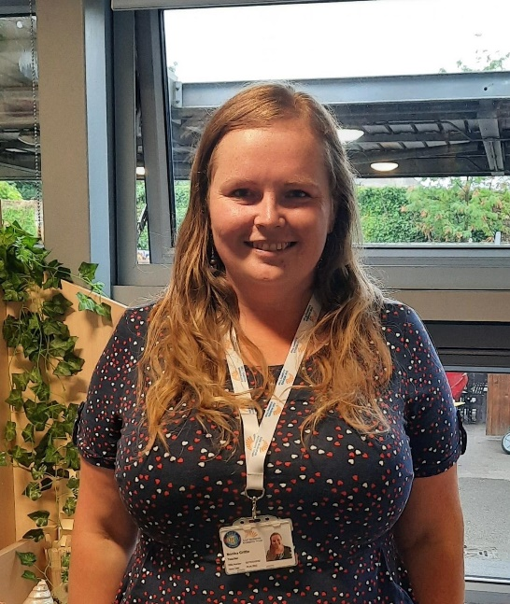
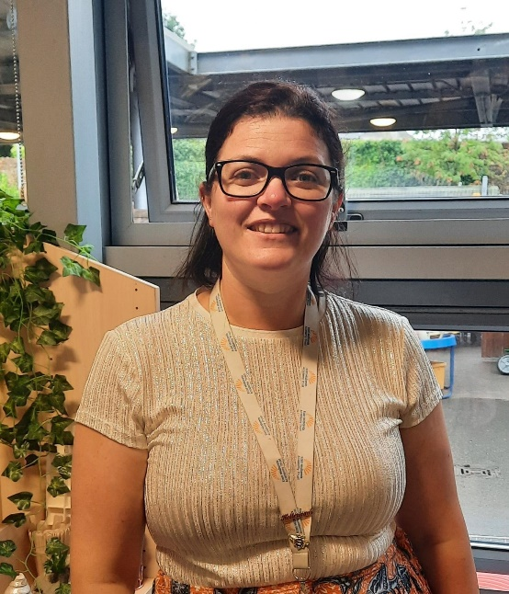
Class teachers
Mrs Griffin Mrs Winter
Tiger Class Panda Class
EYFS Lead
Notes:
Add details of the staffing team

Slide 3
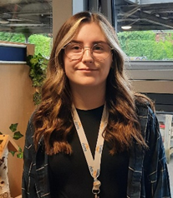
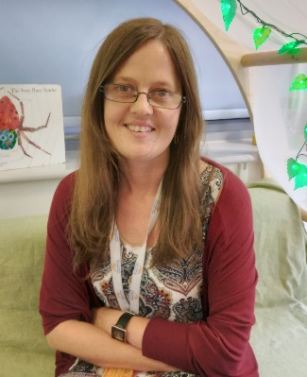
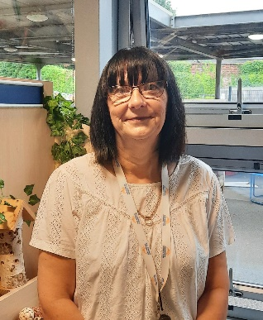
Reception Teaching Assistants
Miss Miss Cooper-Murdin
Mrs Malgorzata Nyendwa
(Mrs Gosia)
Mrs Rowland

Slide 4
Daily Routines
Classroom doors are opened at 8:40am.
The children come in, choose a book to read and sit at the carpet.
Register is taken at 8.45am and lessons start at 9am.
Fruit or vegetables and milk are provided by the school.
We are a water only school.
Lunch from 11:50am to 12.50pm. Lunches are eaten in the hall.
End of day – school finish at 3:15pm
Collection – please notify school about anyone different picking up.
Notes:
Amend lunch time for KS1

Slide 5
PE
Friday PM
Children may wear their P.E kit all day.
No earrings (children must remove themselves). No taping allowed.
PE kit includes:
Plain navy / black shorts
Plain navy / black jogging bottoms
Plain white T-shirt
Plain navy / black hoodie or jumper
Trainers
Sun hat (during summer weather)

Slide 6
Uniform
All items need to be clearly named.
Be smart, shirts tucked in.
No jewellery please.
Earrings must be removed for PE (no tape). They cannot be removed by adults in school.
Jumpers and cardigans . No hoodies (only for PE.)
P.E kit – indoor and outdoor.
Black shoes – no trainers.

Slide 7
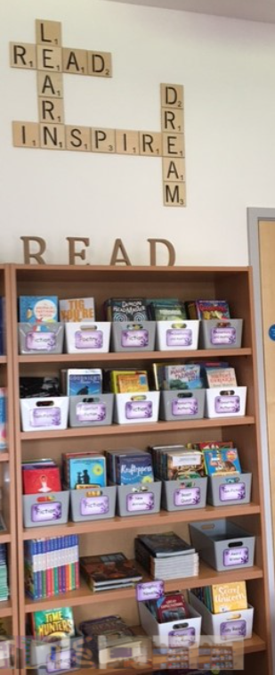
Reading
Reading is vital!
Reading activities take place in school daily.
Books and reading journals must be in school every day
Children must read every day. ‘Reading challenge’ tokens are earned for reading 3 times in a week at home.
Please make comments in reading journals.
Notes:
Can add a personalised picture

Slide 8
Homework
Homework completion is essential
Homework will be sent out on Friday
Homework must be returned to school by the following Thursday Please encourage and support your child.

Slide 9
Homework expectations by year group

Slide 10
Mobile phones must not be used within the school grounds.

Slide 11
Parent Participation
Read with children at home
Support with homework completion
Ensure children are equipped for each day
Reinforce expectations
Keep up to date via the newsletter (mufti days, cake events etc).
Event attendance

Slide 12
Contact and Communication
Open door policy.
The class teacher is always your first point of contact for any issues or questions.
If you need to speak to the class teacher in detail, please book an appointment as time at drop off/collection is limited.
Contact teachers or other staff via the Castle office email address.
Notes in Reading Journals.
Weekly school newsletters.
School website.

Slide 13
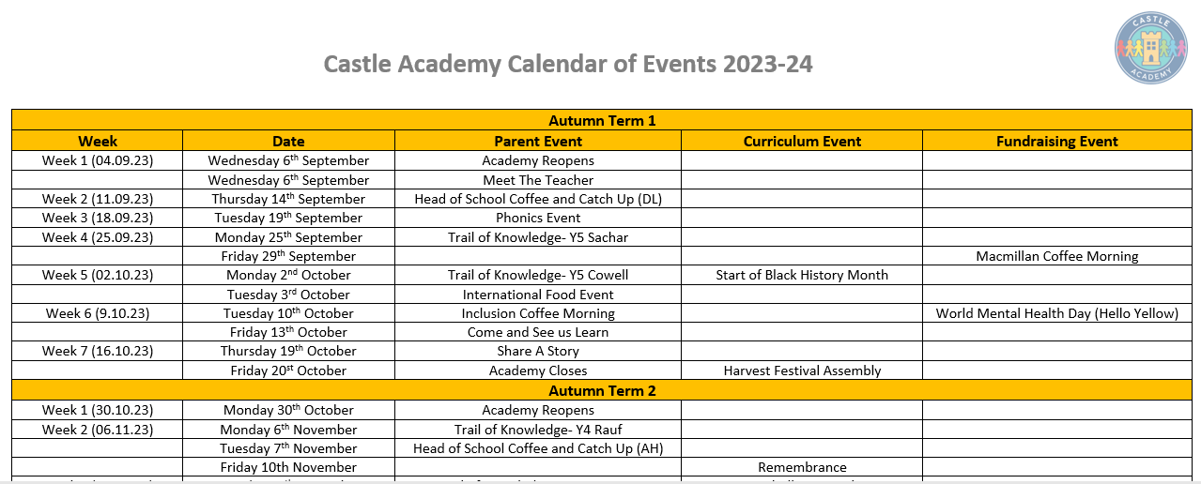

Slide 14
Any Questions

